Slide 1
Name | James
Git Hash | 7dea9616b94abd071b8eac138fec81903c2f621c
Sprint number | Start date | end date | Work hard rating
8 | 19/09/2022 | 17/10/2022 | 4

Slide 2
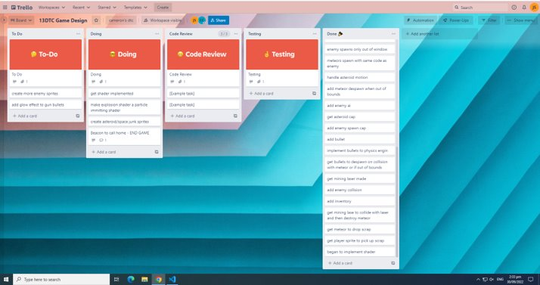
KANBAN board at the start of the sprint

Slide 3
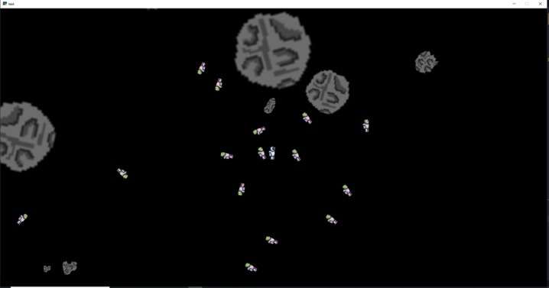
Screenshot of the game at the start of the sprint

Slide 4
Sprint Reflection and summary
I think i did quite a bit of work on this sprint, i was able to add a background to the game consisting of white stars on a black base colour. I added sound to the death of an enemy on impact with a bullet also when the bullet was fired and when a meteor was mined by the player, it took me some time to find some software where i was able to make the sounds but once i found some i had no problem implementing it into the game and it now works fully with the game. I then built views for the game with a start screen, pause screen, story screen, controls screen, win screen, and a death screen, these were also easy to implement due to my prier knowledge on how to make them, they now work fully with the game and are smooth and responsive with very little waiting time while switching between them.
I added health to the player so that the user could both die, i then tested it with anouk and said that the health parameters for thew user were sufficient and didn't negatively affect the game in any way.
Overall this sprint has gone quite well and i was able to get a lot done getting the game closer to being finished.

Slide 5
Briefly describe other team members contributions
Cameron got alot done in this sprint, he was able to complete the inventory giving the player the ability to pick up drop and craft the wining item, this meant the user was able to win the game. He also added and designed some artwork for the items in the game which made the game looked more refined.
He was able to create a sound for when the mining laser fires aswell as adding animation to the enemies so that their arms moved while moving through the game.
Overall he got alot done and he did a good job this sprint

Slide 6
Major Changes and Achievements Described
Added enemy animation where the arms of the enemy move up and down over time via updating its frames and cycling through the animation.
Added sounds for the death of the enemy, firing of the bullet, when an asteroid is mined and when using mining laser, they are either turned on when button is pressed or when contact between two entities are made they then cycle there sound and are then terminated.
Added views; start view, pause view, win view, story view, death view, control view. When the game starts start view first pops up, when enter is pressed it then move to story view, when enter is again pressed the game is then started and switches to game view when ESC is pressed it will go to pause view, ENTER is pressed it will switch to controls view, when LSHIFT is pressed twice it will first switch back to pause view and then back to the game. If the item is crafted the game will then end and switch to win view, if the user dies it will go to death view, from both win and death the user is able to restart the game.
Completed inventory, the player can pick up an item see it in inventory drop it if necessary or use the items to craft the wining item the screwdriver where the game is automatically won.
The player has a health of 1000 each time the player is touched by a enemy it will reduce the players health by 5, there is also health bar at the bottom of the screen that gets smaller as helath reduced

Slide 7
Brief Description of your testing
To test the whether the health on the player could be reduced i started up the game and allowed the enemy to attack and after a short while the player died and switched to death view showing that the health of the player worked i also saw that the health bar got smaller as the player lost health. I then showed anouk whether this was enough health and she agreed and that it added a challenge to the game showing that outside participants agree on the matter that the health works.
To test whether the views worked i started up the game and cycled through all the views to check whether it was smooth and that they worked accordingly, i found that they did and that they work with the game passing testing.
To test that the sounds worked i fired off a bullet into the enemy and when the bullet was fired it made the correct sound and when the enemy died it again made the right sound for the death of the enemy i then tested whether the meteor made the correct sound when it was mined and i found that it did showing that all sounds i implemented worked, i then showed anouk the sounds apart from the meteor mined sound she agreed that they were good and livened up the game. All sounds passed testing but meteor mined sound will need to be tuned.
I also asked anouk whether she liked to use 1 and two to switch between firing lasers or would prefer using left click and right click and firing them imediently. She said the would prefer using left click and right click tow fire between the two. I then Changed way to fire weapon and mining laser, when left mouse click is pressed it will fire the bullet that can kill the enemy, when right click is pressed it will fire the mining laser. I then let her test it again and she said it was better and easier to play the game.

Slide 8
Link to testing results/tables

Slide 9
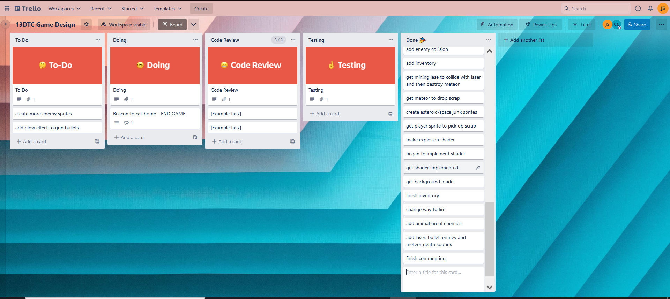
KANBAN board at the end of the sprint

Slide 10
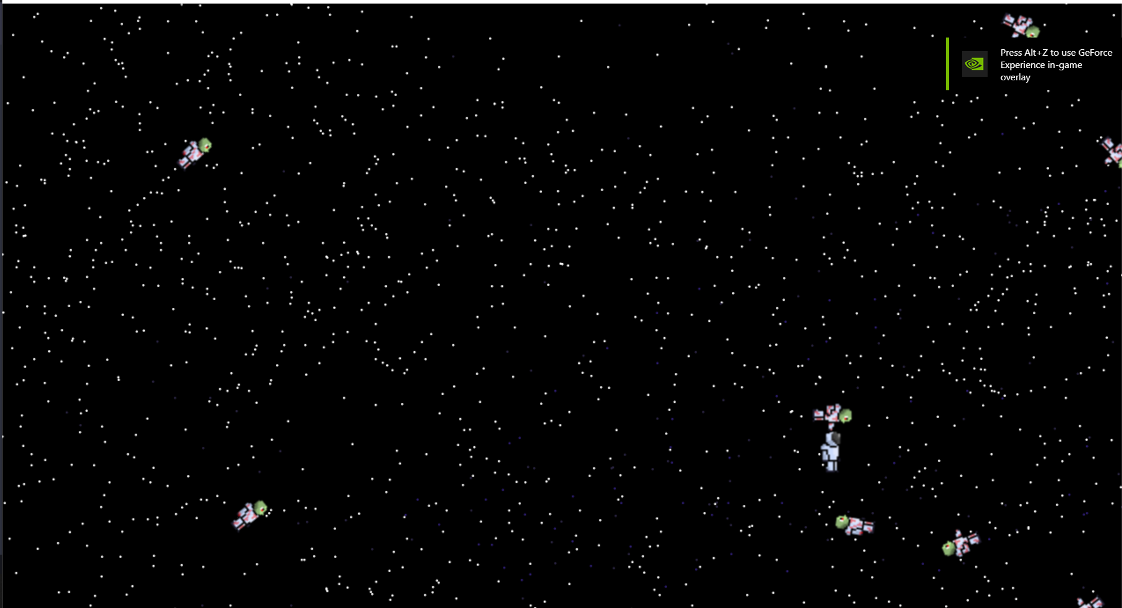
Screenshot of the game at the end of the sprint

Slide 11
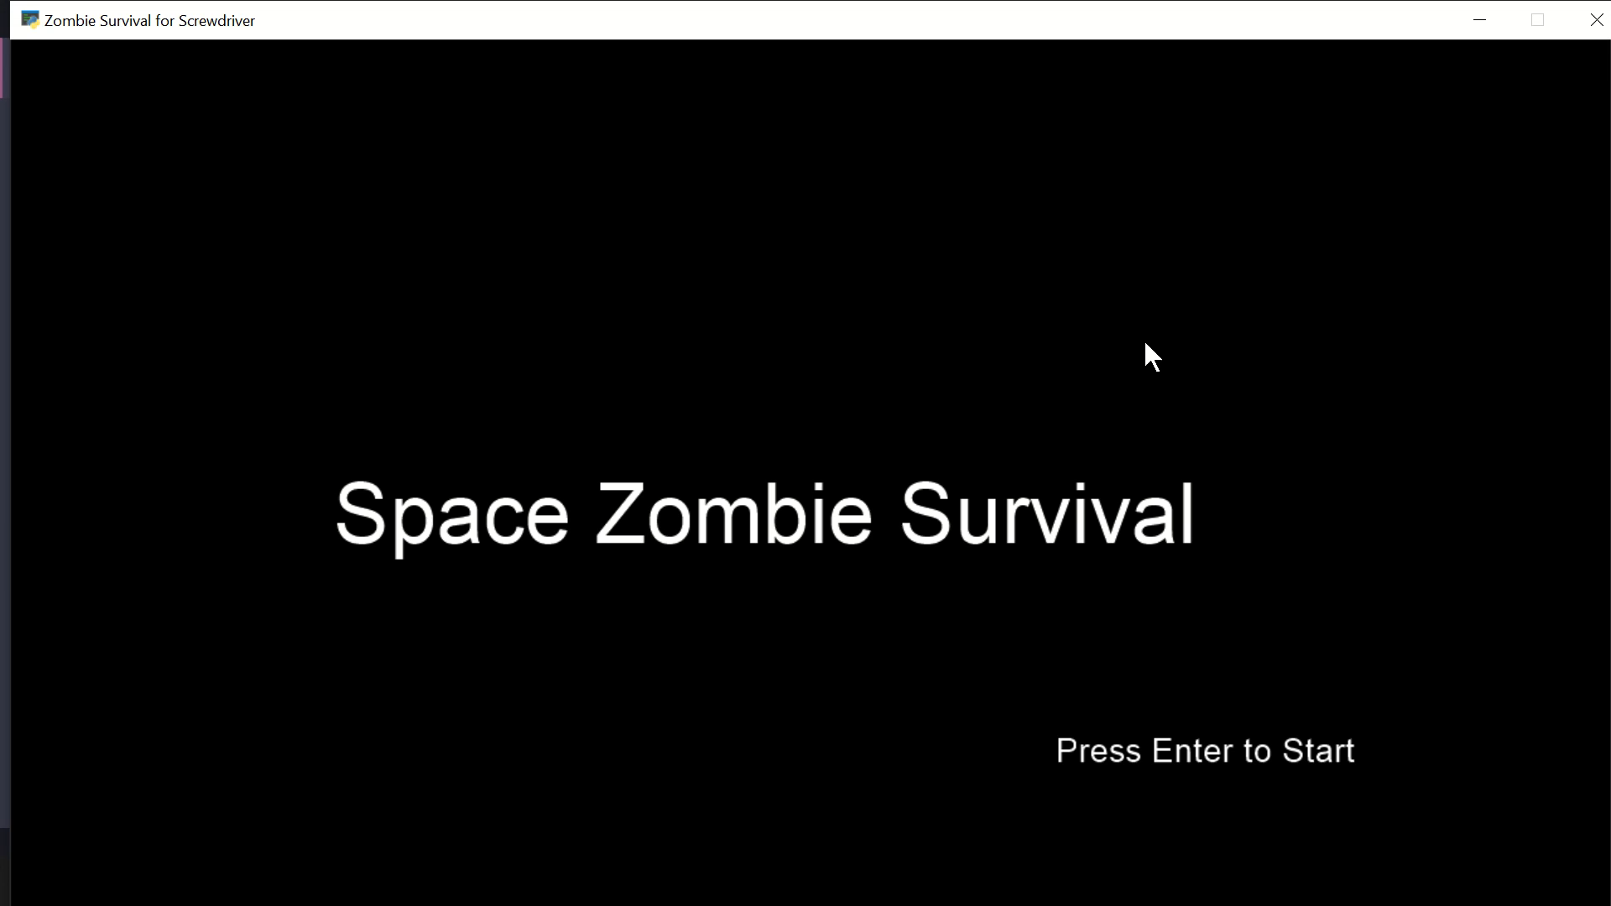
Video of the game at the end of the sprint

Slide 12
Notes for next time, future improvements
Overall this sprint has gone very well and we were able to add a lot of cosmetics to the game getting it pretty much finished I was able to get some feedback from Anouk a stakeholder which gave helpful input on the controls of the firing mechanism. There is still some fine tuning to be done to the game with making the views look more appealing and adding more to the game with more enemy designs and abilities however these improvements can be done in the future with game being able to expand in many ways

